Slide 1
Climate policy decisions and actions Adaptation to climate change in Switzerland
Mohammad Shahidehnia
Paula Maatela

Slide 2
Background information of Switzerland
officially the Swiss Confederation is a federal parliamentary republic consisting of 26 cantons
situated in Western and Central Europe bordered by Italy to the south, France to the west, Germany to the north, and Austria and Liechtenstein to the east
area 41,285 km²
population 8.2 million people
contains three basic topographical areas: the Swiss Alps to the south, the Swiss Plateau or Central Plateau, and the Jura mountains on the west
citizens concentrated mostly on the Plateau

Slide 3
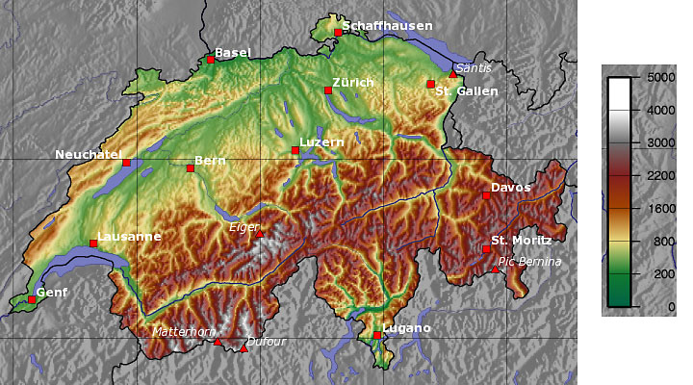
Background information of Switzerland
more than 1500 lakes, contains 6% of Europe's stock of fresh water
lakes and glaciers cover about 6% of the national territory
Original: Captain Blood (de.wikipedia.org) Wikimedia Commons http://commons.wikimedia.org/wiki/File:Schweiz_topo.png Lisenssi: CC-BY-SA-3.0 (www.creativecommons.org/licenses/by-sa/3.0/)

Slide 4
The aims/goals of the strategy & the desired impacts and outcomes
The adaptation strategy is divided into two parts. The first part, describes the goals, challenges and fields of action in adapting to climate change. The second part, due to be available by the end of 2013, will build on this, presenting a plan of action which brings together specific adaptation measures.
The first part of the strategy considers how we can adapt in a range of areas, from water management, natural hazard management, agriculture and forestry to energy, tourism, biodiversity management, health and spatial development.
Fields of action for adapting in these sectors are defined, adaptation goals formulated and possible ways of achieving these goals outlined.
The goal is to use existing synergies in adapting to climate change to the full, and avoid and resolve conflicting objectives.

Slide 5
The most important challenges arising directly from the effects of climate change in Switzerland and to which the country must adapt:
Greater heat stress in agglomerations and cities
Regions affected: Agglomerations and cities
Sectors affected: Spatial development, health, energy
Increasing levels of summer drought
Regions affected: Jura, Southern Alps, inner-alpine dry valleys, small and medium-sized catchment areas in Mittelland, Rhine Valley
Sectors affected: Water management, agriculture, forestry, energy, biodiversity management, spatial development
Greater risk of flooding
Regions affected: Whole of Switzerland
Sectors affected: Water management, natural hazards management, agriculture, energy, tourism, spatial development

Slide 6
The most important challenges arising directly from the effects of climate change in Switzerland and to which the country must adapt are
Decreasing slope stability and more frequent mass wasting
Regions affected: Alpine region Jura
Sectors affected: Natural hazards management, agriculture, forestry, energy, tourism, spatial development
Rising snowline
Regions affected: Alpine region, Jura
Sectors affected: Water management, natural hazards management, energy, tourism, spatial development
Impaired water, soil and air quality
Regions affected: Whole of Switzerland
Sectors affected: Water management, agriculture, forestry, energy, biodiversity management, health, spatial development

Slide 7
The most important challenges arising directly from the effects of climate change in Switzerland and to which the country must adapt are
Change in habitats, species composition and landscapes
Regions affected: Whole of Switzerland
Sectors affected: Water management, agriculture, forestry, biodiversity management, health
Spread of harmful organisms, disease and alien species
Regions affected: Whole of Switzerland below around
2000 m
Sectors affected: Water management, agriculture, forestry, biodiversity management, health

Slide 8
Bases for implementation:
Monitoring and early detection
Reducing uncertainties and closing knowledge gaps
Raising awareness, improving information and coordination
Resource requirements and funding

Slide 9
The greatest challenges in adapting to climate change in Switzerland

Slide 10
Goals and principles of adaptation
Adaptation goals
Switzerland makes the most of the opportunities that arise as a result of climate change.
It minimizes the risks of climate change, protects the population, public assets and natural life support systems and improves the adaptive capacity of society, the economy and the environment.
Principles in adapting to climate change
The process of adaptation is based on the principle of sustainability
Adapting to the effects of climate change involves the whole of society.
Climate change adaptation is a complementary process to the reduction of greenhouse gas emissions.
Adapting to climate change is based on scientific findings

Slide 11
Goals and principles of adaptation
Principles in adapting to climate change continue
Adapting to climate change is based on a risk approach.
Existing uncertainties regarding the future development of global greenhouse gas emissions, of the global and regional climate and the impacts of climate change are taken into account by developing robust measures.
Differences in response timescales among different systems affected by climate change are taken into account in planning and implementing adaptation strategies.
Switzerland takes part in international exchanges of experience regarding adaptation to climate change.
The advances made in adapting to climate change are regularly evaluated.
Adapting to climate change is a dynamic process (periodically revised taking account of changes in the general conditions and of new scientific findings).

Slide 12
In water management need for actions is considered to be particularly high in following areas:
Supply of drinking water,
Comprehensive management of water reservoirs,
Maintaining cooling efficiency in watercooled thermal power plants,
Irrigation

Slide 13
There are also a moderate needs for action in the following water management fields:
Use of groundwater which is adversely affected by low-quality surface water
Effect of leached harmful substances to the quality of ground and surface water
Effect of soil erosion to farming practices
Effects of discharge pattern changes to power plants turbines performance
Changes in fish species and its impact on recreational fishing
Effects of discharge pattern changes and droughts to Rhine’s transport capacity

Slide 14
Fields of action requiring adaptation in natural hazards management:
Floods in alpine region particularly in early summer causing also accelerated erosion on steep slopes
Floods in Mittelland and the Jura
Torrential processes in Alpine region leading to increasingly frequent sudden landslides and risk of mudslides and debris avalanches
Gravitational processes in Alpine region leading to increased rockfall activity in many areas
Protection of forest from temperature rise, increasing drought and frequent storms

Slide 15
Fields of action requiring adaptation in agriculture:
Site suitability for agricultural production (effects of climate change to landscape)
Heavy rainfall (increases the risk of soil erosion and leaching, particularly during periods of low vegetation)
Drought
Heat stress in plants and animals
Pests and diseases due to spread of new harmful organisms in crops and among farm animals
Price volatility caused by fluctuations in crop yields due to climate variability

Slide 16
Fields of action requiring adaptation in forestry:
Critical protection forests
Conifer-rich forests in low-lying areas
Climate-sensitive forest sites
Other forest sites

Slide 17
Fields of action requiring adaptation in the energy sector:
Energy demand for air conditioning and cooling of buildings
Generation of electricity from hydropower
Generation of electricity from thermal power plants
Maintenance and safety of transport infrastructure due to bedrock destabilisation and increased mass wasting

Slide 18
Fields of action requiring adaptation in tourism:
Development of tourism supply
Hazard minimization due to weather extremes
Communication among the actors in the tourism industry in individual destinations to join forces

Slide 19
Fields of action requiring adaptation in biodiversity management
Gene pool for the long-term survival of species with a low capacity for adaptation and small populations.
Habitats and species with both a positive and a negative impact on species , and development of new habitats and communities.
Spread of invasive alien species
Biotope network /connectivity
Ecosystem services

Slide 20
Fields of action requiring adaptation in the health sector
Vector-borne diseases (humans and animals)
Effects of heat (humans and animals) to cardiovascular conditions, dehydration, overheating and impaired performance.
Food- and water-borne diseases (humans)

Slide 21
Fields of action requiring adaptation in spatial development
Quality of life in cities and agglomerations
Tourism
Natural hazards

Slide 22
Role of federal offices in strategy development
The FOEN is responsible both for drafting the first part of the adaptation strategy and for coordinating the drafting of the action plan. The adaptation strategy forms the basis for the federal offices’ coordinated course of action for adapting to climate change. This is a long-term task. List of the federal offices that are primarily responsible for dealing as interfaces between the fields of action:
Federal Office for Spatial Development (ARE)
Federal Office for Civil Protection (FOCP)
Federal Office for the Environment (FOEN)
Federal Office of Public Health (FOPH)
Swiss Federal Office of Energy (SFOE)
Federal Office for Agriculture (FOAG)
Federal Veterinary Office (FVO)
Federal Finance Administration (FFA)
Federal Office for Meteorology and Climatology (MeteoSwiss)
State Secretariat for Economic Affairs (SECO)

Slide 23
Interfaces between adaptation strategy and other strategies and policies
The adaptation strategy will be coordinated with the
Federal Council’s “Sustainable Development Strategy”
action plan for the legislative period 2012–15.
There are numerous interfaces and overlaps with
the sectoral programmes, strategies and policies.

Slide 24
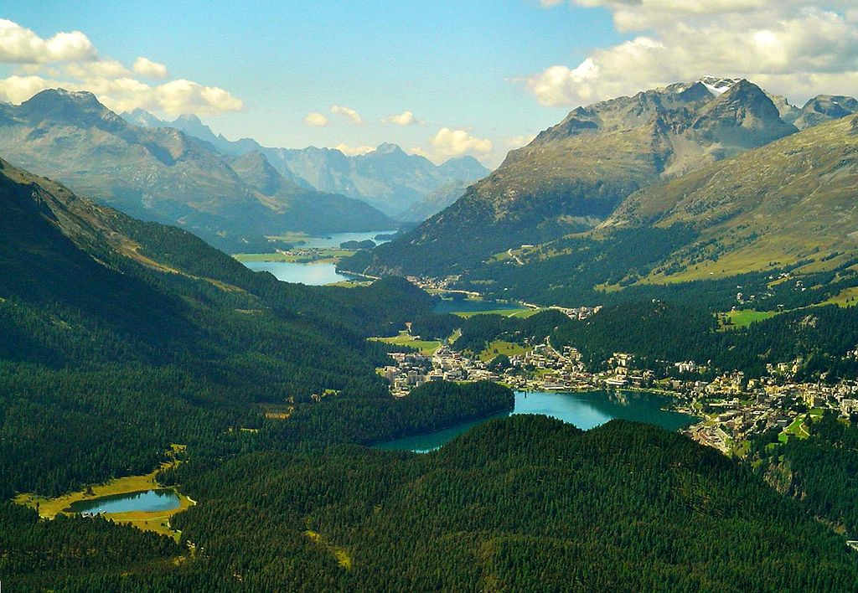
Thank you!
The Engadin Valley. Photo by Biovit http://commons.wikimedia.org/wiki/File:Engadine.jpg#/media/File:Engadine.jpg

